Slide 1
COMPOSITE DAMAGE TOLERANCE (CDT)
Residual strength after BVID impact
Guillermo Balsalobre Carmona
Julio de 2025

Slide 2
Index:
BVID impact criterion
Design values
CDT module of SAM software
Case study
Suggestion for future CDT analyses
References

Slide 3
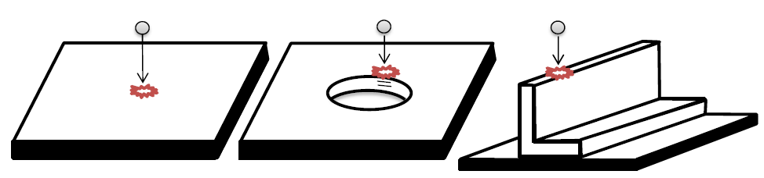
Residual strength after BVID impact criterion:
· BVID – Barely Visible Impact Damage. It is the damage in a composite laminate
consequence of a low velocity impact at the threshold of (visible) detectability.
· Low energy impact (typ. E=35J)
· Transversal and Edge impact:

Slide 4
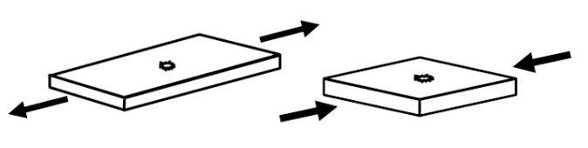
Design values:
TAI: Tension After Impact, as allowable strain
CAI: Compression After Impact, as allowable strain
BAI: Bending After Impact, as allowable strain
Sketch of impacted laminates (tension & compression)

Slide 5
TAI: Tension After Impact, as allowable strain:
IMA-M21E_UD Tape
TAI allowable is a constant material property.
Same B-basis value for all conditions.
TAI allowable takes minimum values are not affected by the temperature.
Airbus DS approximation: TAI is a fixed value for each material, independent of fibre directionality or thickness.
BAI: Bearing After Impact, as allowable strain:
Depends on material. Can be calculated, but for IMA-M21E_UD Tape, and in the absence of more precise test data, TAI is used as cut-off value for BAI.

Slide 6
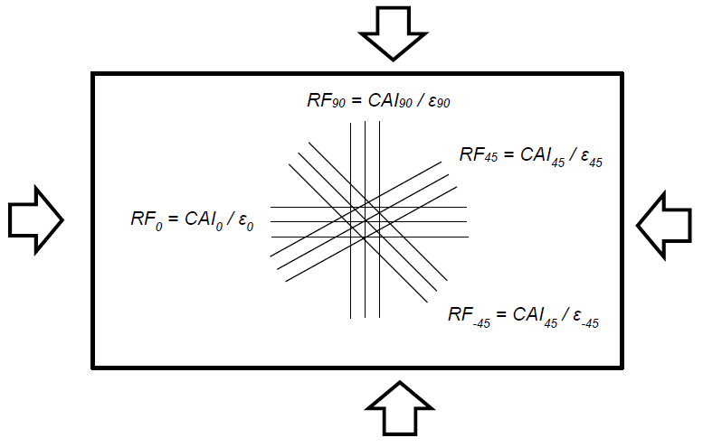
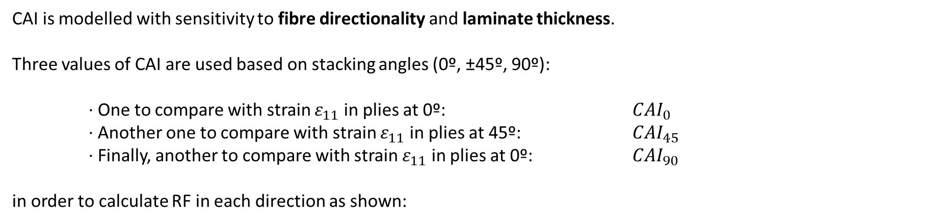
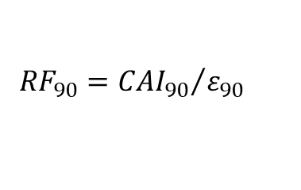
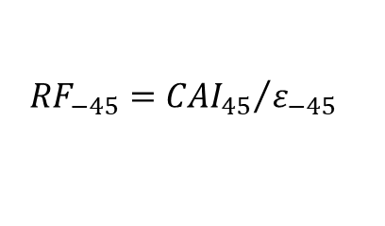
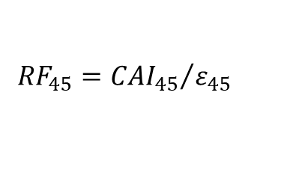
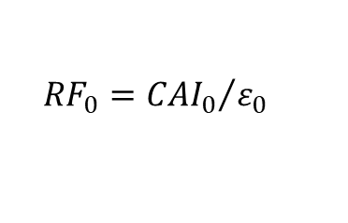
CAI: Compression After Impact, as allowable strain:
CAI is modelled with sensitivity to fibre directionality and laminate thickness.
Three values of CAI are used based on stacking angles (0º, ±45º, 90º):
· One to compare with strain $ε_{11}$ in plies at 0º: ${CAI}_{0}$
· Another one to compare with strain $ε_{11}$ in plies at 45º: ${CAI}_{45}$
· Finally, another to compare with strain $ε_{11}$ in plies at 0º: ${CAI}_{90}$
in order to calculate RF in each direction as shown:
$${RF}_{0}={{CAI}_{0}}/{ε_{0}}$$
$${RF}_{45}={{CAI}_{45}}/{ε_{45}}$$
Sketch with static margins for all ply directions in a plate under bi-axial compression
$${RF}_{−45}={{CAI}_{45}}/{ε_{−45}}$$
$${RF}_{90}={{CAI}_{90}}/{ε_{90}}$$

Slide 7
CAI: Compression After Impact, as allowable strain:
IMA-M21E_UD Tape
CAI depends on impact energy, material - elastic modulus of material and of direction of interest, thickness of each fibre direction, temperature…
CAI allowable increase with the laminate thickness and there is a reduction of the allowable value with the Temperature
Each laminate needs 3 CAI calculations… CDT software

Slide 8
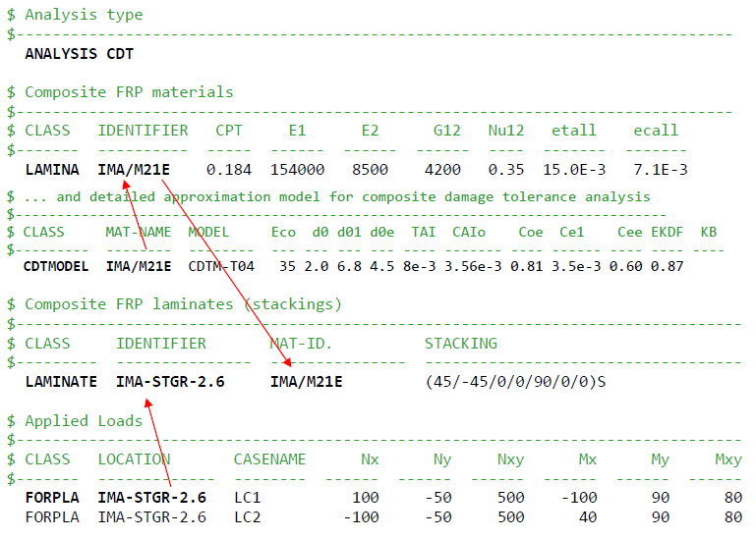
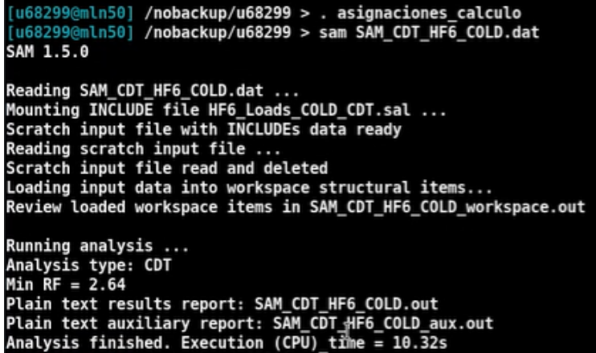
CDT module of SAM software:
SAM software: “Structural Analysis Method” is a Airbus DS software for performing different types of structural analysis using experimental stress methods under development.
module CDT: “Composite Damage Tolerance” for residual strength after BVID impact analysis

Slide 9
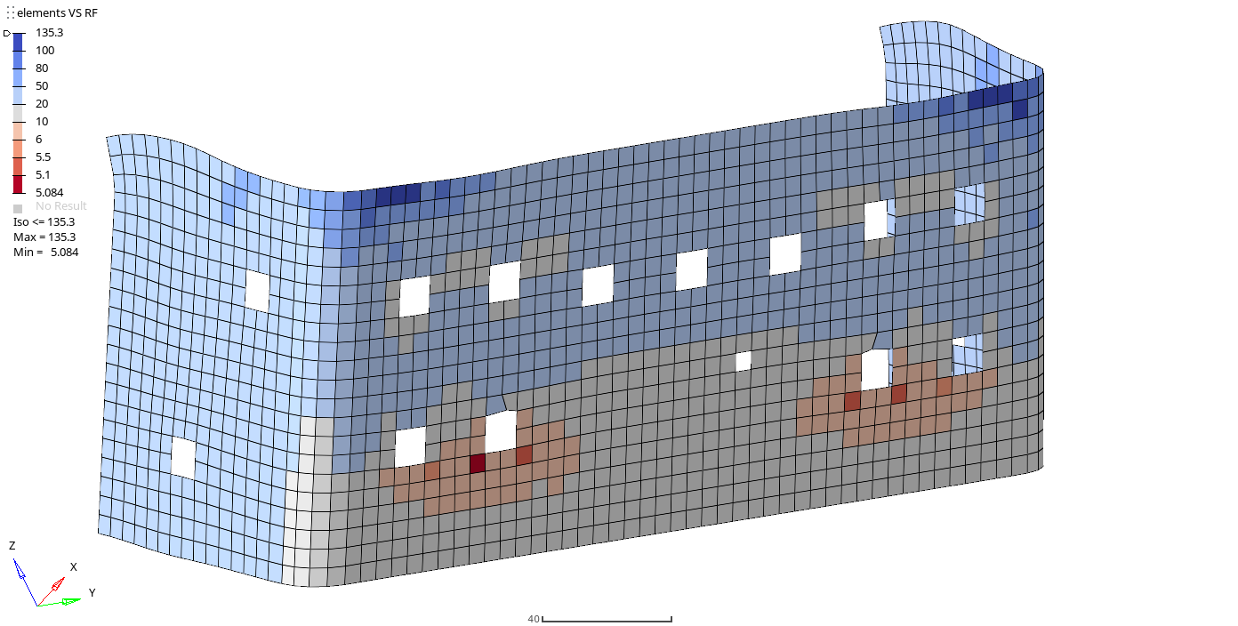
Case study:
Falcon 10X
Fittings HTP (Box and Elevator) & VTP (Box and Rudder)
CDT analysis on Spar and Skin surroundings of fittings
Each location: HF1-HF6 (2 of them with 2 extra Fail safe cases), +Fy/-Fy, Cold/Hot

Slide 10
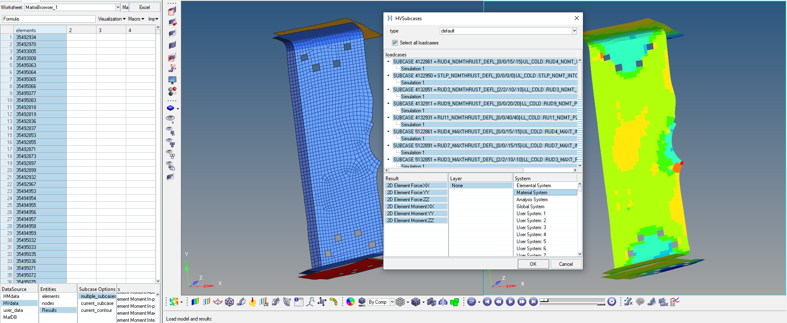
Pre processing:
Hypermesh Matrix Browser
from DFEM forces results
Excel postprocessing in HF1_Loads_COLD_CDT.xls
CDT Load Input “.sal”
*results in material system

Slide 11
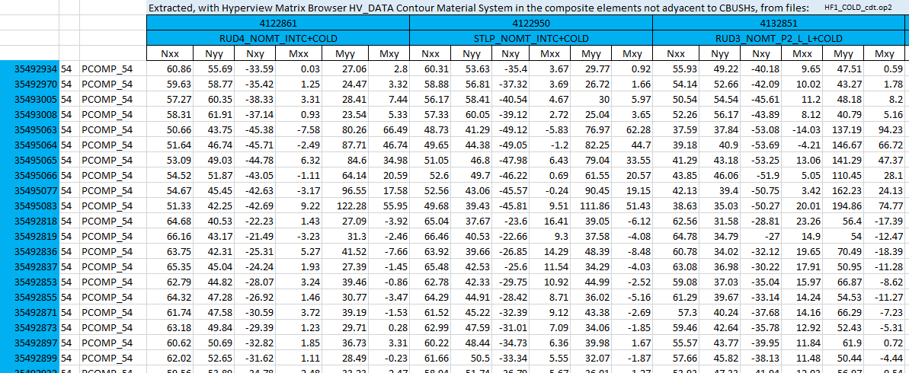
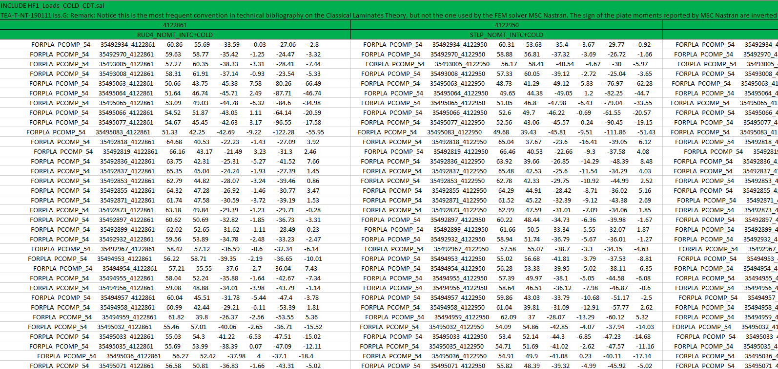
Pre processing:
Hypermesh Matrix Browser
from DFEM forces results
Excel postprocessing in “HF1_Loads_COLD_CDT.xls”
CDT Load Input “.sal”
(*)
Reorder in SAM format
(*) sign of moments are inverted

Slide 12
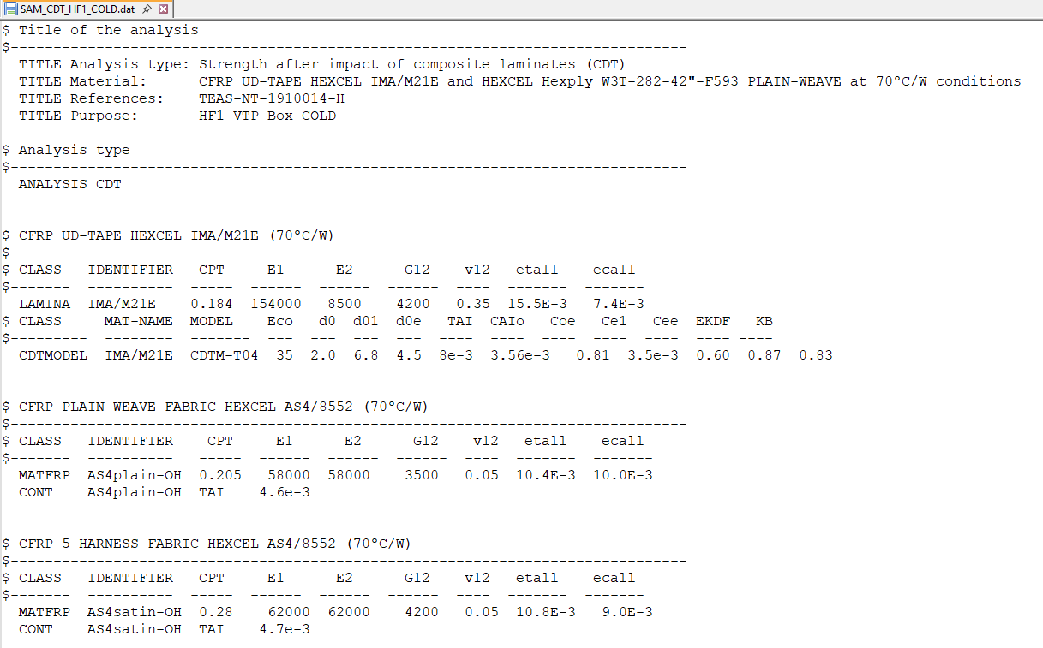
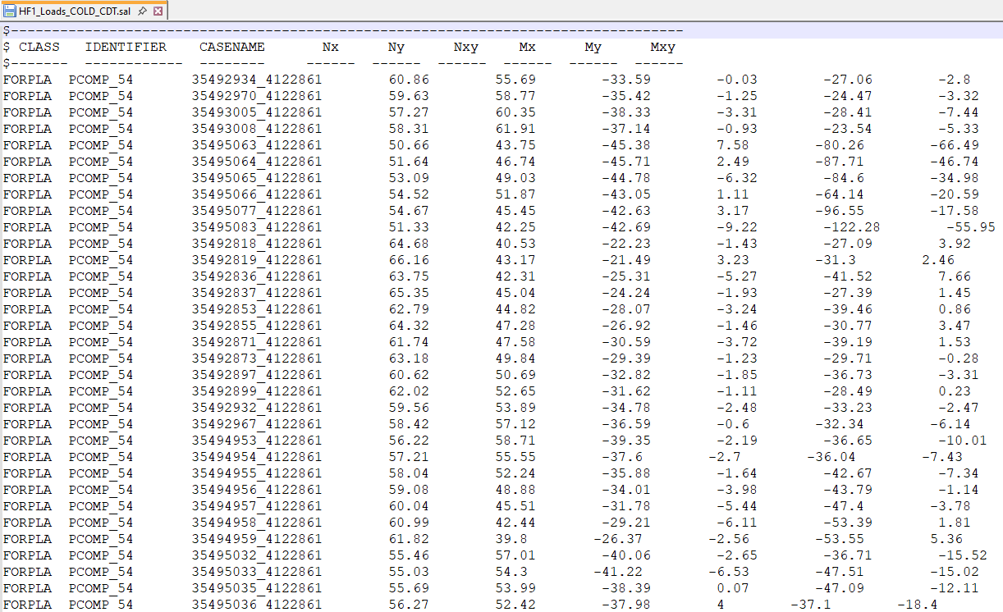
Inputs:
“SAM_CDT_HF1_COLD.dat”
“HF1_Loads_COLD_CDT.sal”
excelpreprocessing

Slide 13
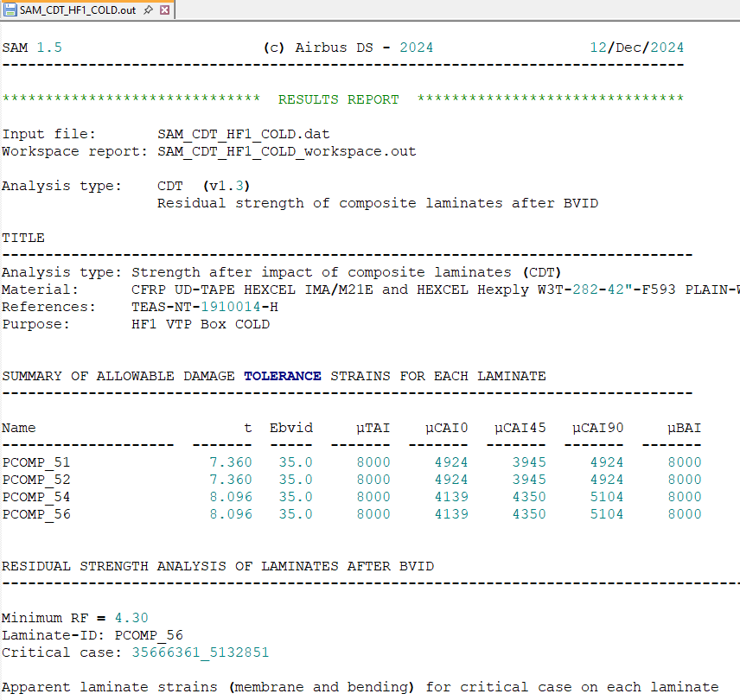
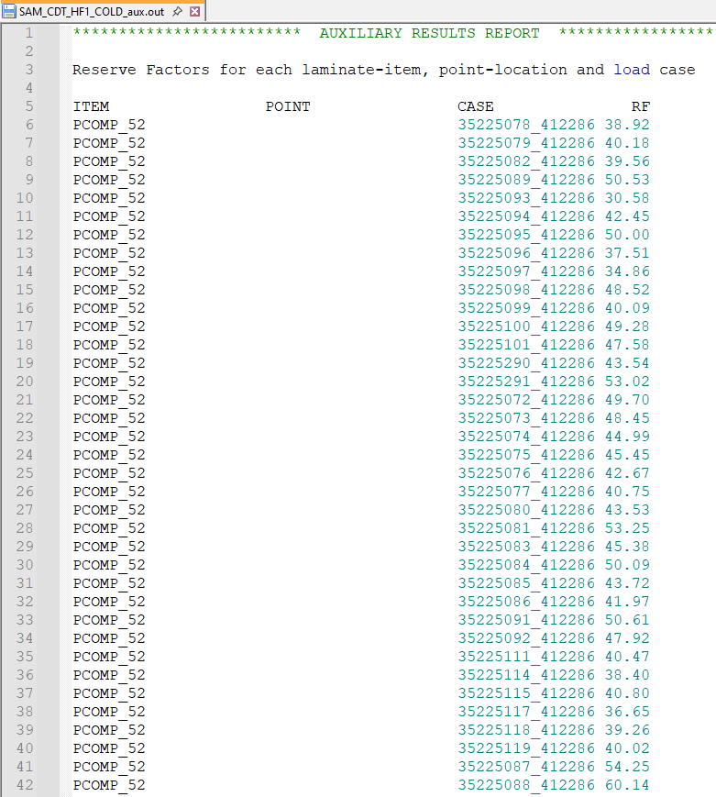
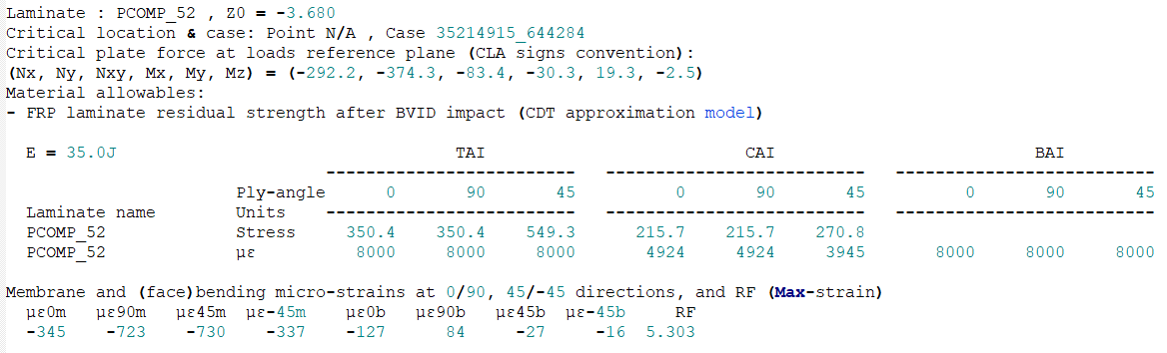
Outputs:
“SAM_CDT_HF1_COLD.out”
“SAM_CDT_HF1_COLD.aux.out”

Slide 14
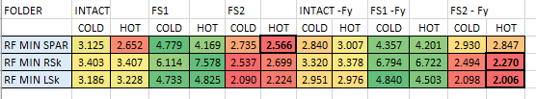
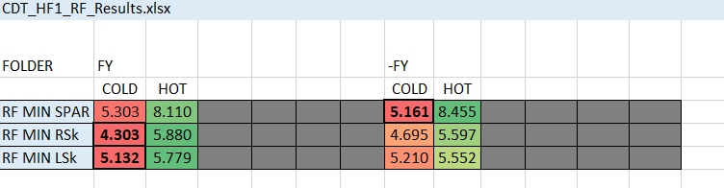
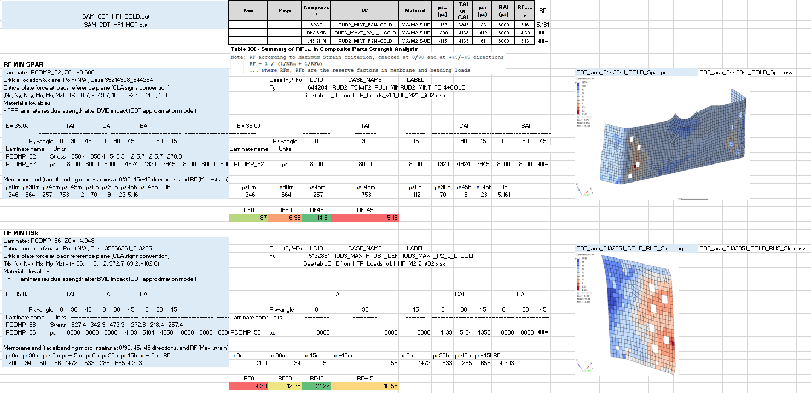
Post processing:
“SAM_CDT_HF1_COLD.out” ,“SAM_CDT_HF1_HOT.out”, … (para FY/-FY, FS…)
“CDT_HF1-RF_Results.xlsx”

Slide 15
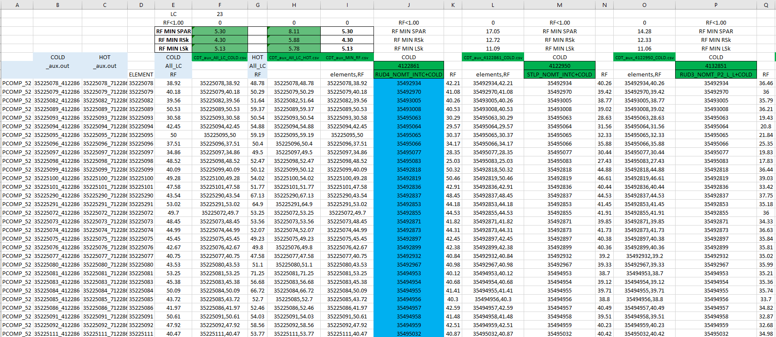
Post processing:
“SAM_CDT_HF1_COLD.aux.out” & “…HOT.aux.out”
“CDT_HF1_RF_Results.xlsx”

Slide 16
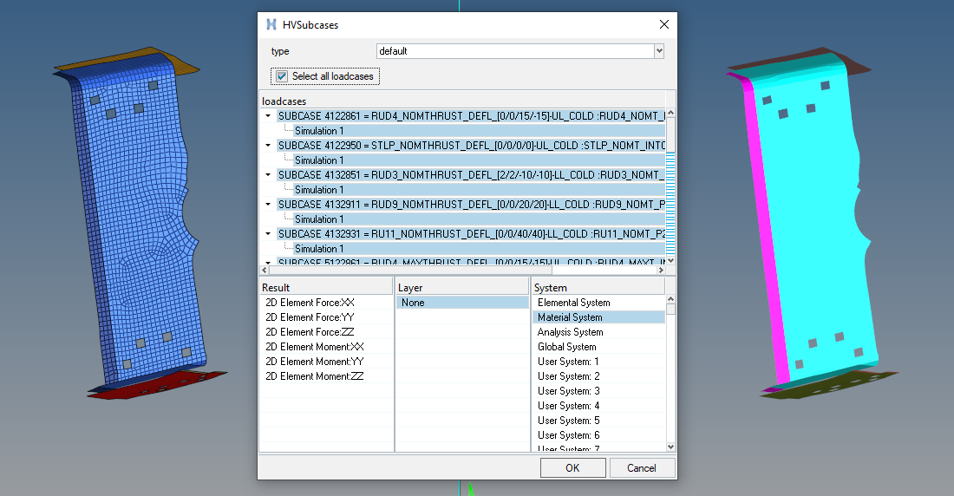
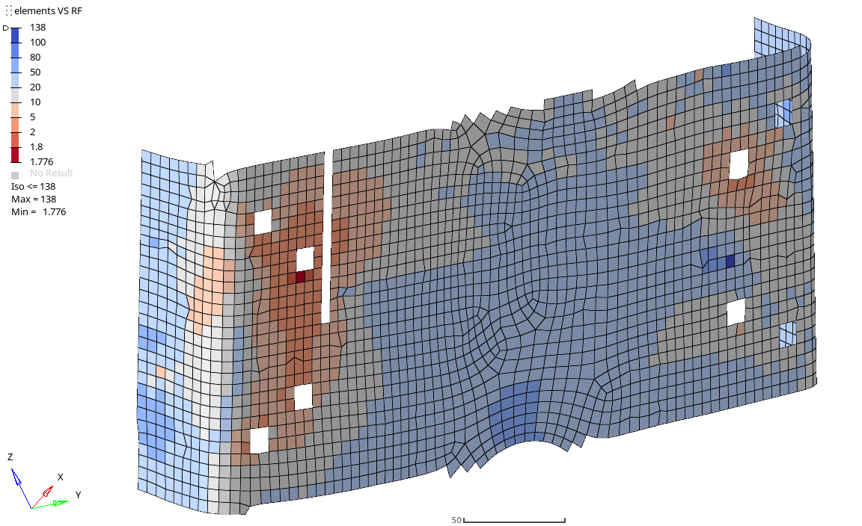
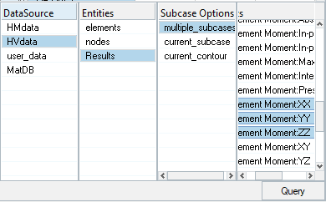
Suggestions for future CDT analyses:
· Preprocessing automatization: Directly from “.op2” results, obtain “loads.sal” input for CDT analysis with python
Avoid mistakes with Matrix Browser: license dependent and sometimes hace lo que le da la gana.
Saving time in preprocessing excel preparation: each fitting HFx_Loads_COLD_CDT.xlsx rows & columns must be updated manually depending on number of elements and loadcases.
¿?

Slide 17
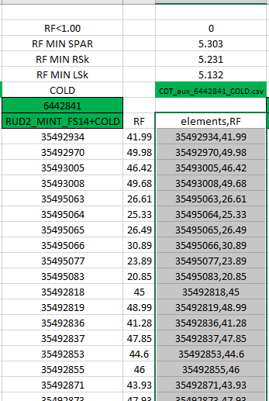
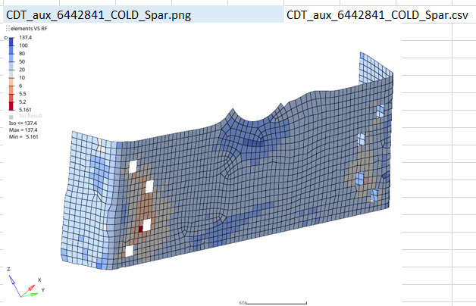
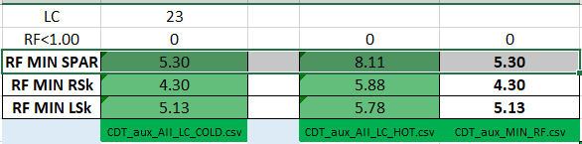
Suggestions for future CDT analyses:
· Postprocessing automatization: Postprocessing all results from “.aux.out” directly with python
Again, saving time in postprocessing excel preparation, where each fitting CDT_HFx_RF_Results.xlsx must be updated depending on number of elements and loadcases.
Instead of this, obtain ONLY needed information directly from “.aux.out”

Slide 18
References:
· TEAS-NT-1910014-J: Material Design Values and Methods for Structural Analysis of the Future Falcon
· TEA-T-NT-190111-J_SAM: SAM Stress Software User’s Reference Manual
· SMM_section1.4_chapter1451_CFRP_IMA-M21E-UD

